Slide 1
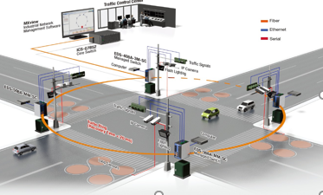
INTELLIGENT TRAFFIC INFORMATION SYSTEM
SMART CITIES…….

Slide 2
Science and technology has always taken humanity to a whole new level of luxury. One such important machinery invention by man are the vehicles, which help us to reduce the transportation speed. As the population increased the demand for private vehicles also started to increase and all of these increasing demand send educing problem called as the traffic congestion. Traffic congestion is one of the unnoticed problems that happen as are Result of urbanization of the cities specialising developing countries like India
INTRODUCTION

Slide 3
NEED FOR SMART TRAFFIC CONTROL SYSTEM
Improper working of the traffic signals such as the emission of green light in roads that are empty and red lights in the areas where vehicles are stagnating for a long time.
In developing countries like India, the metro train projects also credit to its cause.
Sudden out break of the structure of roads.
Construction of new bridges.
Failure of the traffic signals.
Lack of traffic police in the required areas.

Slide 4
IOT IN TRAFFIC CONGESTION MONITORING
Internet of things aims at providing a ubiquitous internet connection to almost all the devices.
In this project, cameras are the basic modules used .All of the cameras will be setup with an internet protocol address to aid in effective communication and automation of traffic signals.

Slide 5

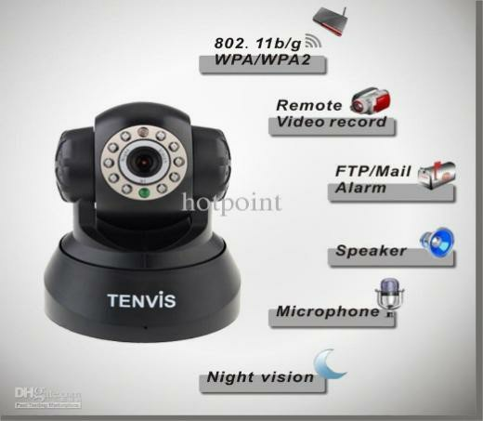
REQUIREMENTS
IOT SERVERS
Web Cam
IoT severs are used as aids in transmission and reception of data from devices used as nodes in Internet of Things
A webcam is a camera device that accesses real time data and transmits using an internet network.

Slide 6
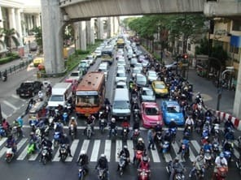
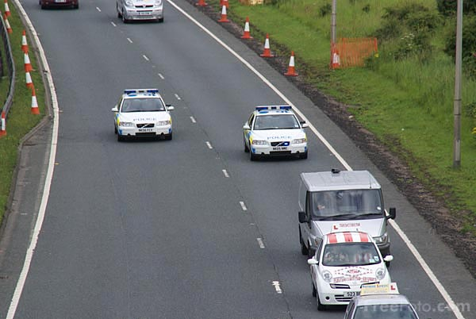
BASIC CONSIDERATION OF INPUT
ROAD WITH HIGH VEHICHE DENSITY
ROAD WITH LOW VEHICLE DENSITY

Slide 7
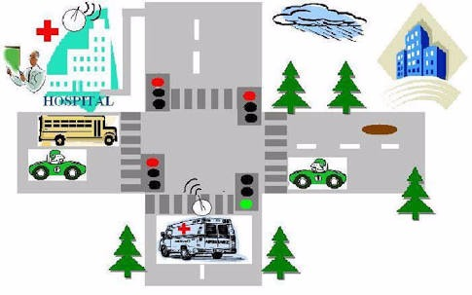
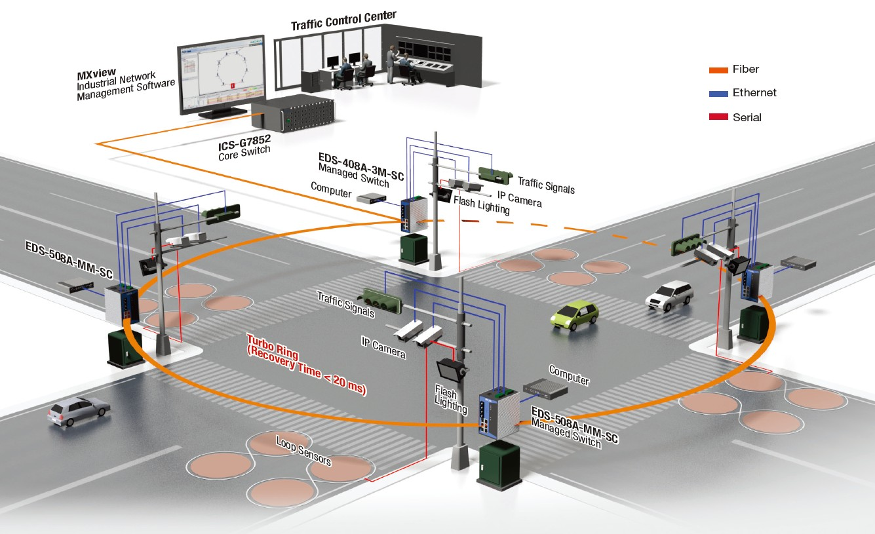
EXPECTED IMPLEMENTATION OF PROJECT OUTCOME

Slide 8
ARCHITECTURE OF THIS PROJECT
Background
Camera
subtraction
Traffic
Density
Edge
controller
EDGE detection
calculation
Altering of traffic
lights

Slide 9

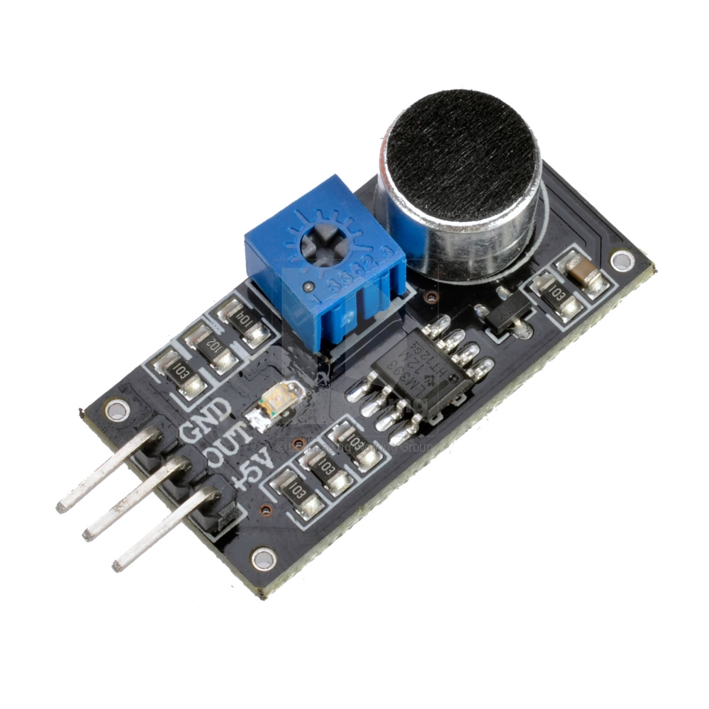
HARDWARES USED
RASPBERRY PI
SOUND SENSOR
Raspberry-pi is a micro computer used in implementing small scale projects.
Model pi3B used in implementing this project.
The Sound sensor module is a simple microphone that can be used to detect sound strength of environment

Slide 10
Background subtraction, also known as foreground detection, is a technique in the fields of image processing and computer vision wherein an image's foreground is extracted for further processing (object recognition etc.). Generally an image's regions of interest are objects (humans, cars, text etc.) in its foreground. After the stage of image preprocessing (which may include image denoising, post processing like morphology etc.) object localization is required which may make use of this technique.
BACKGROUND SUBTRACTION

Slide 11
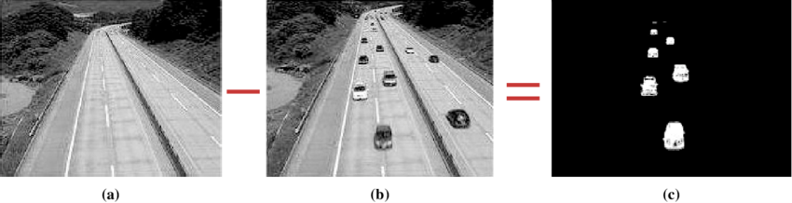
BACKGROUND SUBTRACTION

Slide 12
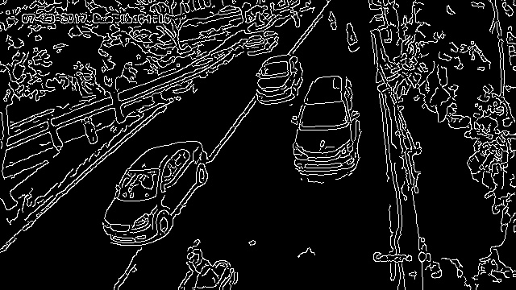
EDGE DETECTION
Edge detection includes a variety of mathematical methods that aim at identifying points in a digital image at which the image brightness changes sharply or has discontinuities.
The points at which image brightness changes sharply are typically organized into a set of curved line segments termed edges.
Edge detection is a fundamental tool in image processing.

Slide 13
EDGE DETECTION ALGORITHM CANNY EDGE DETECTION
Canny edge detection is a technique to extract useful structural information from different vision objects and dramatically reduce the amount of data to be processed. It has been widely applied in various computer vision systems. Canny has found that the requirements for the application of edge detection on diverse vision systems are relatively similar. Thus, an edge detection solution to address these requirements can be implemented in a wide range of situations. The general criteria for edge detection include:
Detection of edge with low error rate, which means that the detection should accurately catch as many edges shown in the image as possible
The edge point detected from the operator should accurately localize on the center of the edge.
A given edge in the image should only be marked once, and where possible, image noise should not create false edges.

Slide 14
GAUSSIAN FILTER
Since all edge detection results are easily affected by image noise, it is essential to filter out the noise to prevent false detection caused by noise. To smooth the image, a Gaussian filter is applied to convolve with the image. This step will slightly smooth the image to reduce the effects of obvious noise on the edge detector.

Slide 15
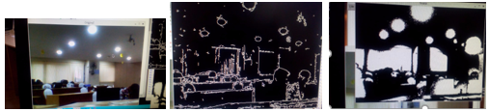
OUTPUT – EDGE DETECTION WITH BACKGROUND SUBTRACTION

Slide 16
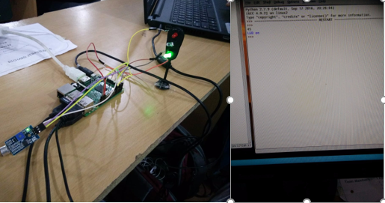
INTELLIGENT TRAFFIC SYSTEM

Slide 17
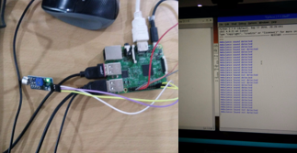
AMBULANCE DETECTION

Slide 18
The project discusses the strategy of handling incomprehensible population and vehicle growth, traffic congestion levels in the cities . A smoke sensor will be added to have a database on pollution occurrence and control.
FUTURE ENHANCEMENTS

Slide 19
THANK YOU
BY
HAARINI S (RIT,IT)
ASWINI N(REC,ECE)
ANUSREE DINESHAN (REC,ECE)
ASHWINI T (REC,ECE)

